Slide 1

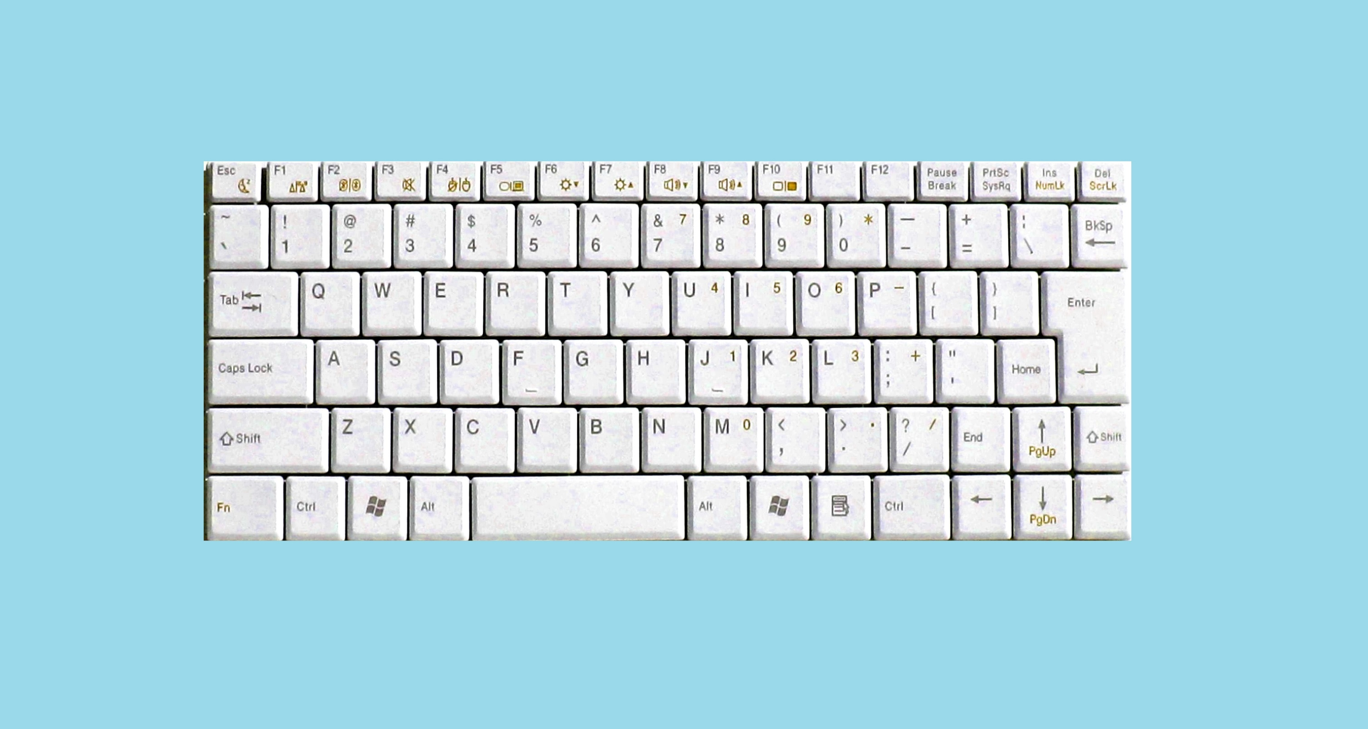
Basic Control
(No GamePad)
Direction
Show River Force
Show River Force
Direction
Drift
Drift
Player1
Use item
Select item
Select item
Use item
Player2

Slide 2
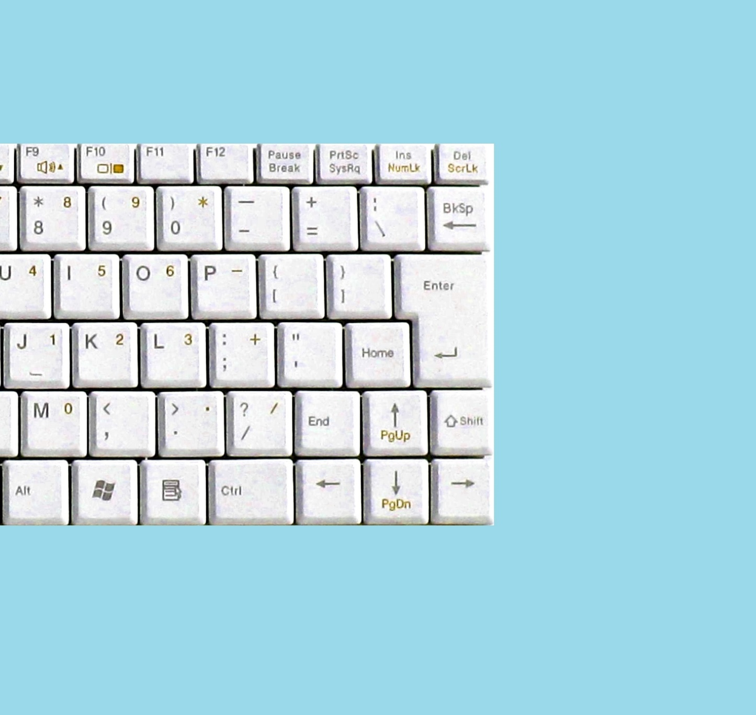
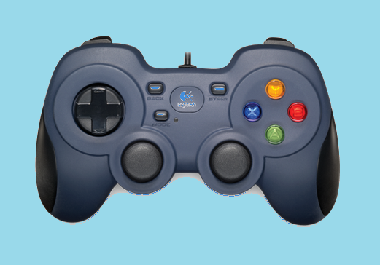
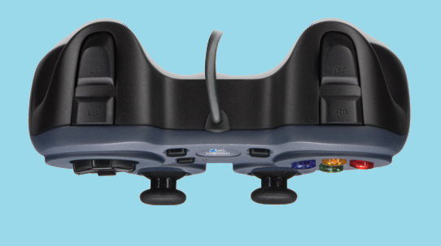
Basic Control
(With GamePad)
Direction
Use item
Show River Force
Show River Force
Direction
Drift
Drift
Player1
Select item
Use item
Player2
Select item

Slide 3

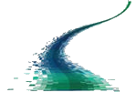
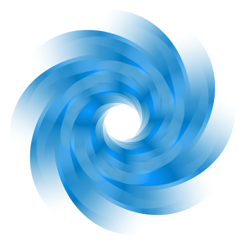
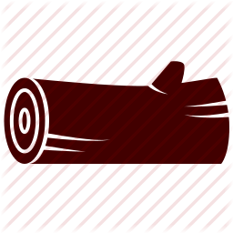
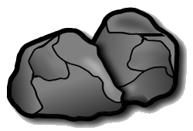

The racing track is a river with following elements.
River: The river’s wave changes randomly and will have weak influence on boats.
Vortex: The vortex will draw your boat and you’d better keep away from it.
Log: Hitting the logs will slow your boat down a bit and your boat may go through the hole without being effected.
Rock: Hitting the rocks will slow your boat greatly.
Border: Hitting the borders will slow your boat a bit and you should avoid to cling to the borders.

Slide 4

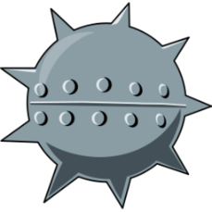
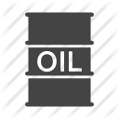
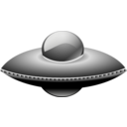
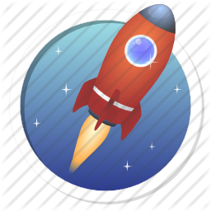
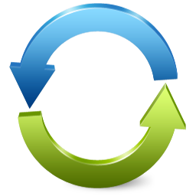

Items: Hitting the item box, you will get a
random item from below.
Water Mine: Leave a water mine behind, hit the water mine will crash the boat and relocate the boat to the position where it was 5 seconds ago.
Oil Barrel: Leave an oil barrel behind, hit the barrel will make boat slippery for a while.
UFO: Slow down all the other opponent boats for a while.
Boost: Get a higher speed and a higher
acceleration for a while.
Reverse: Reverse your opponent control for a while.
Shield: Protect the boat from the negative effects once.

